Slide 1
Foundations of Modern Networking
SDN, NFV, QoE, IoT, and Cloud
By: William Stallings

Slide 2
Chapter 3
SDN: Background and Motivation
Notes:
After studying this chapter, you should be able to
■ Make a presentation justifying the position that traditional network architectures are inadequate
for modern networking needs.
■ List and explain the key requirements for an SDN architecture.
■ Present an overview of an SDN architecture, to include explaining the significance of
northbound and southbound APIs.
■ Summarize the work being done on SDN and NFV standardization by various organizations.

Slide 3
Evolving Network Requirements
A number of trends are driving network providers and users to reevaluate traditional approaches to network architecture
Demand is increasing
Cloud computing
Big data
Mobile traffic
The Internet of Things (IoT)
Supply is increasing
Traffic
Notes:
A number of trends are driving network providers and users to reevaluate traditional
approaches to network architecture. These trends can be grouped under the categories
of demand, supply, and traffic patterns.
As was described in Chapter 2, “Requirements and Technology,” a number of trends
are increasing the load on enterprise networks, the Internet, and other internets. Of
particular note are the following:
■ Cloud computing: There has been a dramatic shift by enterprises to both
public and private cloud services.
■ Big data: The processing of huge data sets requires massive parallel
processing on thousands of servers, all of which require a degree of interconnection
to each other. Therefore, there is a large and constantly growing
demand for network capacity within the data canter.
■ Mobile traffic: Employees are increasingly accessing enterprise network
resources via mobile personal devices, such as smartphones, tablets, and
notebooks. These devices support sophisticated apps that can consume and
generate image and video traffic, placing new burdens on the enterprise
network.
■ The Internet of Things (IoT): Most “things” in the IoT generate modest
traffic, although there are exceptions, such as surveillance video cameras. But
the sheer number of such devices for some enterprises results in a significant
load on the enterprise network.
As the demand on networks is rising, so is the capacity of network technologies to
absorb rising loads. In terms of transmission technology, Chapter 1, “Elements of
Modern Networking,” established that the key enterprise wired and wireless network
technologies, Ethernet and Wi-Fi respectively, are well into the gigabits per second
(Gbps) range. Similarly, 4G and 5G cellular networks provide greater capacity for
mobile devices from remote employees who access the enterprise network via cellular
networks rather than Wi-Fi.
The increase in the capacity of the network transmission technologies has been
matched by an increase in the performance of network devices, such as LAN switches,
routers, firewalls, intrusion detection system/intrusion prevention systems (IDS/IPS),
and network monitoring and management systems. Year by year, these devices have
larger, faster memories, enabling greater buffer capacity and faster buffer access, as
well as faster processor speeds.
If it were simply a matter of supply and demand, it would appear that today’s networks
should be able to cope with today’s data traffic. But as traffic patterns have changed
and become more complex, traditional enterprise network architectures are increasingly
ill suited to the demand.
Until recently, and still common today, the typical enterprise network architecture
consisted of a local or campus-wide tree structure of Ethernet switches with routers
connecting large Ethernet LANs and connecting to the Internet and WAN facilities.
This architecture is well suited to the client/server computing model that was at
one time dominant in the enterprise environment. With this model, interaction, and
therefore traffic, was mostly between one client and one server. In such an environment,
networks could be laid out and configured with relatively static client and
server locations and relatively predictable traffic volumes between clients and servers.
A number of developments have resulted in far more dynamic and complex traffic
patterns within the enterprise data center, local and regional enterprise networks, and
carrier networks. These include the following:
■ Client/server applications typically access multiple databases and servers that
must communicate with each other, generating “horizontal” traffic between
servers as well as “vertical” traffic between servers and clients.
■ Network convergence of voice, data, and video traffic creates unpredictable
traffic patterns, often of large multimedia data transfers.
■ Unified communications (UC) strategies involve heavy use of applications that
trigger access to multiple servers.
■ The heavy use of mobile devices, including personal bring your own device
(BYOD) policies, results in user access to corporate content and applications
from any device anywhere any time. As illustrated previously in Figure 2.6 in
Chapter 2, this mobile traffic is becoming an increasingly significant fraction
of enterprise network traffic.
■ The widespread use of public clouds has shifted a significant amount of what
previously had been local traffic onto WANs for many enterprises, resulting in
increased and often very unpredictable loads on enterprise routers.
■ The now-common practice of application and database server virtualization has
significantly increased the number of hosts requiring high-volume network access
and results in every-changing physical location of server resources.

Slide 4
Traditional Network Architectures are Inadequate
As QoS and QoE requirements imposed on the network are expanded as a result of the variety of applications, the traffic load must be handled in an increasingly sophisticated and agile fashion
The traditional internetworking approach is based on the TCP/IP protocol architecture; characteristics of this approach are:
Two-level end system addressing
Routing based on destination
Distributed, autonomous control
Notes:
Even with the greater capacity of transmission schemes and the greater performance
of network devices, traditional network architectures are increasingly inadequate in
the face of the growing complexity, variability, and high volume of the imposed load.
In addition, as quality of service (QoS) and quality of experience (QoE) requirements
imposed on the network are expanded as a result of the variety of applications, the
traffic load must be handled in an increasingly sophisticated and agile fashion.
The traditional internetworking approach is based on the TCP/IP protocol architecture .
Three noteworthy characteristics of this approach are as follows:
■ Two-level end system addressing
■ Routing based on destination
■ Distributed, autonomous control
Let’s look at each of these characteristics in turn.
The traditional architecture relies heavily on the network interface identity. At the
physical layer of the TCP/IP model, devices attached to networks are identified by
hardware-based identifiers, such as Ethernet MAC addresses. At the internetworking
level, including both the Internet and private internets, the architecture is a network
of networks. Each attached device has a physical layer identifier recognized within
its immediate network and a logical network identifier, its IP address, which provides
global visibility.
The design of TCP/IP uses this addressing scheme to support the networking of autonomous
networks, with distributed control. This architecture provides a high level of
resilience and scales well in terms of adding new networks. Using IP and distributed
routing protocols, routes can be discovered and used throughout an internet. Using
transport-level protocols such as TCP, distributed and decentralized algorithms can be
implemented to respond to congestion.
Traditionally, routing was based on each packet’s destination address. In this
datagram approach, successive packets between a source and destination may follow
different routes through the internet, as routers constantly seek to find the minimumdelay
path for each individual packet . More recently, to satisfy QoS requirements,
packets are often treated in terms of flows of packets. Packets associated with a given
flow have defined QoS characteristics, which affect the routing for the entire flow.

Slide 5
Limitations
The Open Networking Foundation (ONF) cites four general limitations of traditional network architectures:
Static, complex architecture
Inconsistent policies
Inability to scale
Vendor dependence
Notes:
However, this distributed, autonomous approach developed when networks were
predominantly static and end systems predominantly of fixed location. Based on these
characteristics, the Open Networking Foundation (ONF) cites four general limitations
of traditional network architectures [ONF12]:
■ Static, complex architecture: To respond for demands such as differing
levels of QoS, high and fluctuating traffic volumes, and security requirements,
networking technology has grown more complex and difficult to manage. This
has resulted in a number of independently defined protocols each of which addresses
a portion of networking requirements. An example of the difficulty this
presents is when devices are added or moved. The network management staff
must use device-level management tools to make changes to configuration
parameters in multiple switches, routers, firewalls, web authentication portals,
and so on. The updates include changes to access control lists (ACLs), virtual
LAN settings, QoS settings in numerous devices, and other protocol-related
adjustments. Another example is the adjustment of QoS parameters to meet
changing user requirements and traffic patterns. Manual procedures must be
used to configure each vendor’s equipment on a per-application and even per-session
basis.
■ Inconsistent policies: To implement a network-wide security policy, staff
may have to make configuration changes to thousands of devices and mechanisms.
In a large network, when a new virtual machine is activated, it can take
hours or even days to reconfigure ACLs across the entire network.
■ Inability to scale: Demands on networks are growing rapidly, both in
volume and variety. Adding more switches and transmission capacity,
involving multiple vendor equipment, is difficult because of the complex,
static nature of the network. One strategy enterprises have used is to oversubscribe
network links based on predicted traffic patterns. But with the increased
use of virtualization and the increasing variety of multimedia applications,
traffic patterns are unpredictable.
■ Vendor dependence: Given the nature of today’s traffic demands on networks,
enterprises and carriers need to deploy new capabilities and services
rapidly in response to changing business needs and user demands. A lack of
open interfaces for network functions leaves the enterprises limited by the relatively
slow product cycles of vendor equipment.

Slide 6
The SDN Approach
Requirements:
Adaptability
Networks must adjust and respond dynamically, based on application needs, business policy, and network conditions
Automation
Policy changes must be automatically propagated so that manual work and errors can be reduced
Maintainability
Introduction of new features and capabilities must be seamless with minimal disruption of operations
Model management
Network management software must allow management of the network at a model level, rather than implementing conceptual changes by reconfiguring individual network elements
Mobility
Control functionality must accommodate mobility, including mobile user devices and virtual servers
Integrated security
Network applications must integrate seamless security as a core service instead of as an add-on solution
On-demand scaling
Implementations must have the ability to scale up or scale down the network and its services to support on-demand requests
Notes:
Based on the narrative of Section 3.1, we are now in a position to detail the principal
requirements for a modern networking approach. The Open Data Center Alliance
(ODCA) provides a useful, concise list of requirements, which include the following
[ODCA14]:
■ Adaptability: Networks must adjust and respond dynamically, based on application
needs, business policy, and network conditions.
■ Automation: Policy changes must be automatically propagated so that
manual work and errors can be reduced.
■ Maintainability. Introduction of new features and capabilities (software
upgrades, patches) must be seamless with minimal disruption of operations.
■ Model management: Network management software must allow
management of the network at a model level, rather than implementing
conceptual changes by reconfiguring individual network elements.
■ Mobility: Control functionality must accommodate mobility, including mobile
user devices and virtual servers.
■ Integrated security: Network applications must integrate seamless security
as a core service instead of as an add-on solution.
■ On-demand scaling: Implementations must have the ability to scale up or
scale down the network and its services to support on-demand requests.

Slide 7
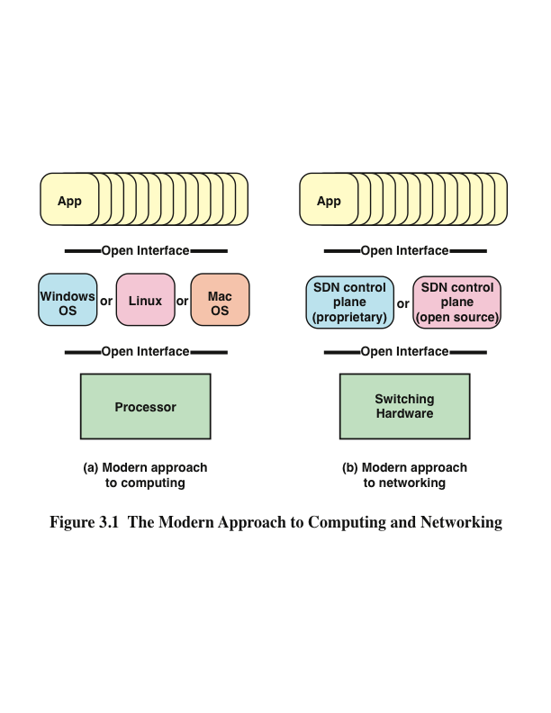
Notes:
An analogy can be drawn between the way in which computing evolved from closed,
vertically integrated, proprietary systems into an open approach to computing and
the evolution coming with SDN (see Figure 3.1). In the early decades of computing,
vendors such as IBM and DEC provided a fully integrated product, with a proprietary
processor hardware, unique assembly language, unique operating system (OS), and
the bulk if not all of the application software. In this environment, customers, especially
large customers, tended to be locked in to one vendor, dependent primarily
on the applications offered by that vendor. Migration to another vendor’s hardware
platform resulted in major upheaval at the application level.
Today, the computing environment is characterized by extreme openness and
great customer flexibility. The bulk of computing hardware consists of x86 and
x86-compatible processors for standalone systems and ARM processors for embedded
systems. This makes it easy to port operating systems implemented in C, C++, Java,
and the like. Even proprietary hardware architectures, such as IBM’s zEnterprise line,
provide standardized compilers and programming environments and so can easily
run open sources operating systems such as Linux. Therefore, applications written
for Linux or other open operating systems can easily be moved from one vendor
platform to another. Even proprietary systems such as Windows and Mac OS provide
programming environments to make porting of applications an easy matter. It also
enables the development of virtual machines that can be moved from one server to
another across hardware platforms and operating systems.

Slide 8
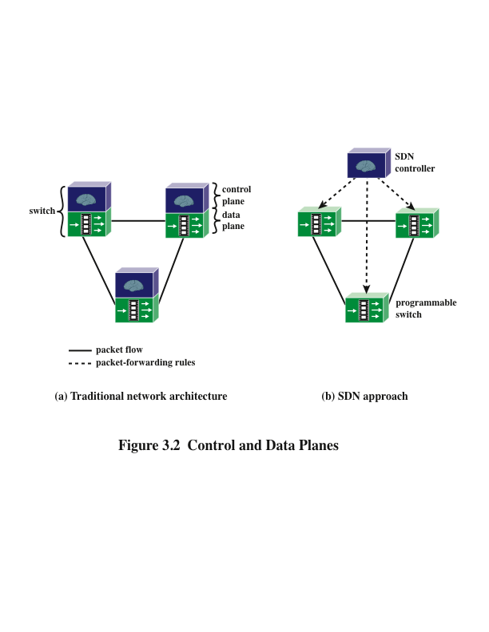
Notes:
The networking environment today faces some of the same limitations faced in the
pre-open era of computing. Here the issue is not developing applications that can run
on multiple platforms. Rather, the difficulty is the lack of integration between applications
and network infrastructure. As demonstrated in the preceding section, traditional
network architectures are inadequate to meet the demands of the growing volume and
variety of traffic.
The central concept behind SDN is to enable developers and network managers
to have the same type of control over network equipment that they have had over
x86 servers. As discussed in Section 2.6 in Chapter 2, the SDN approach splits the
switching function between a data plane and a control plane that are on separate
devices (see Figure 3.2). The data plane is simply responsible for forwarding
packets, whereas the control plane provides the “intelligence” in designing routes,
setting priority and routing policy parameters to meet QoS and QoE requirements
and to cope with the shifting traffic patterns. Open interfaces are defined so that
the switching hardware presents a uniform interface regardless of the details of
internal implementation. Similarly, open interfaces are defined to enable networking
applications to communicate with the SDN controllers.

Slide 9
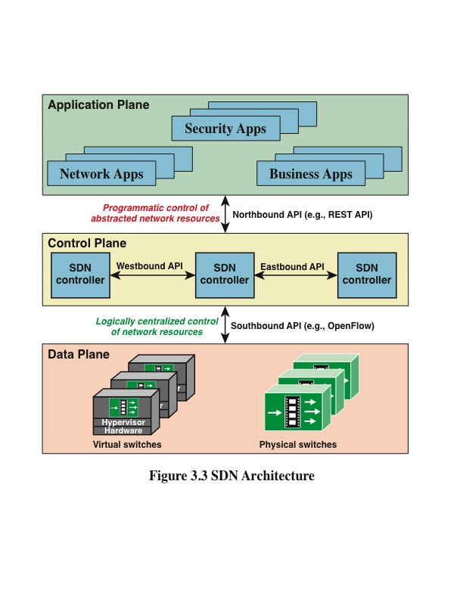
Notes:
Figure 3.3 elaborates on the structure shown in Figure 2.15, showing more detail of
the SDN approach. The data plane consists of physical switches and virtual switches.
In both cases, the switches are responsible for forwarding packets. The internal
implementation of buffers, priority parameters, and other data structures related to
forwarding can be vendor dependent. However, each switch must implement a model,
or abstraction, of packet forwarding that is uniform and open to the SDN controllers.
This model is defined in terms of an open application programming interface
(API) between the control plane and the data plane (southbound API). The most prominent
example of such an open API is OpenFlow, discussed in Chapter 4, “SDN Data
Plane and OpenFlow.” As Chapter 4 explains, the OpenFlow specification defines
both a protocol between the control and data planes and an API by which the control
plane can invoke the OpenFlow protocol.
SDN controllers can be implemented directly on a server or on a virtual server.
OpenFlow or some other open API is used to control the switches in the data plane.
In addition, controllers use information about capacity and demand obtained from the
networking equipment through which the traffic flows. SDN controllers also expose
northbound APIs, which allow developers and network managers to deploy a wide
range of off-the-shelf and custom-built network applications, many of which were not
feasible before the advent of SDN. As yet there is no standardized northbound API
nor a consensus on an open northbound API. A number of vendors offer a REpresentational
State Transfer (REST)-based API to provide a programmable interface to
their SDN controller.
Also envisioned but not yet defined are horizontal APIs (east/westbound), which
would enable communication and cooperation among groups or federations of
controllers to synchronize state for high availability.
At the application plane are a variety of applications that interact with SDN controllers.
SDN applications are programs that may use an abstract view of the network for their
decision-making goals. These applications convey their network requirements and
desired network behavior to the SDN controller via a northbound API. Examples of
applications are energy-efficient networking, security monitoring, access control, and
network management.

Slide 10
Characteristics of Software-Defined Networking
The control plane is separated from the data plane; data plane devices become simple packet-forwarding devices
The control plane is implemented in a centralized controller or set of coordinated centralized controllers
The SDN controller has a centralized view of the network or networks under its control
The controller is portable software that can run on commodity servers and is capable of programming the forwarding devices based on a centralized view of the network
Open interfaces are defined between the devices in the control plane (controllers) and those in the data plane
The network is programmable by applications running on top of the SDN controllers; the SDN controllers present an abstract view of network resources to the applications
Notes:
Putting it all together, the key characteristics of SDN are as follows:
■ The control plane is separated from the data plane. Data plane devices become
simple packet-forwarding devices (refer back to Figure 3.2).
■ The control plane is implemented in a centralized controller or set of coordinated
centralized controllers. The SDN controller has a centralized view of the
network or networks under its control. The controller is portable software that
can run on commodity servers and is capable of programming the forwarding
devices based on a centralized view of the network.
■ Open interfaces are defined between the devices in the control plane
(controllers) and those in the data plane.
■ The network is programmable by applications running on top of the SDN
controllers. The SDN controllers present an abstract view of network
resources to the applications.

Slide 11
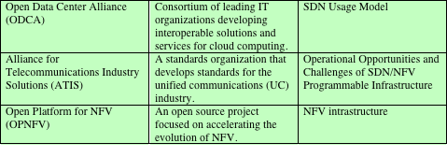
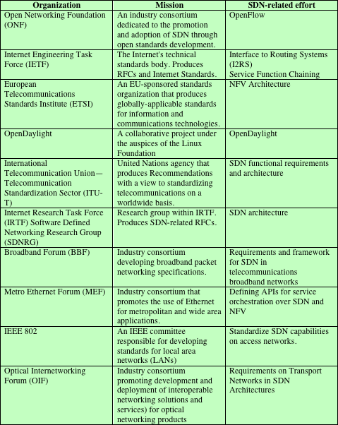
Table 3.1
SDN and NFV
Standards
Activities
Notes:
Unlike some technology areas, such as Wi-Fi, there is no single standards body
responsible for developing open standards for SDN and NFV. Rather, there is a
large and evolving collection of standards-developing organizations (SDOs), industrial
consortia, and open development initiatives involved in creating standards and
guidelines for SDN and NFV. Table 3.1 lists the main SDOs and other organizations
involved in the effort and the main outcomes so far produced. This section covers
some of the most prominent efforts.

Slide 12
Standards-Developing Organizations
Internet Society (ISOC)
The coordinating committee for Internet design, engineering, and management
Areas covered include the operation of the Internet itself and the standardization of protocols used by end systems on the Internet for interoperability
Various organizations under the ISOC are responsible for the actual work of standards development and publication
Notes:
The Internet Society, ITU-T, and ETSI are all making key contributions to the standardization
of SDN and NFV.
A number of standards-developing organizations (SDOs) are looking at
various aspects of SDN. Perhaps the most active are two groups within the Internet
Society (ISOC): IETF and IRTF. ISOC is the coordinating committee for Internet
design, engineering, and management. Areas covered include the operation of the
Internet itself and the standardization of protocols used by end systems on the Internet
for interoperability. Various organizations under the ISOC are responsible for the
actual work of standards development and publication.

Slide 13
Internet Engineering Task Force (IETF)
Has working groups developing SDN-related specifications in the following areas:
Interface to routing systems (I2RS)
Develop capabilities to interact with routers and routing protocols to apply routing policies
Service function chaining
Develop an architecture and capabilities for controllers to direct subsets of traffic across the network in such a way that each virtual service platform sees only the traffic it must work with
Notes:
The Internet Engineering Task Force (IETF) has working groups developing SDN-related
specifications in the following areas:
■ Interface to routing systems (I2RS): Develop capabilities to interact with
routers and routing protocols to apply routing policies.
■ Service function chaining : Develop an architecture and capabilities for
controllers to direct subsets of traffic across the network in such a way that
each virtual service platform sees only the traffic it must work with.

Slide 14
Notes:
The Internet Research Task Force (IRTF) has published Software-Defined Networking
(SDN): Layers and Architecture Terminology (RFC 7426, January 2015). The
document provides a concise reference that reflects current approaches regarding
the SDN layer architecture. The Request For Comments (RFC) also provides
a useful discussion of the southbound API (Figure 3.3) and describes some specific
APIs, such as for I2RS.
IRTF also sponsors the Software Defined Networking Research Group (SDNRG).
This group investigates SDN from various perspectives with the goal of identifying
the approaches that can be defined, deployed, and used in the near term and identifying
future research challenges.

Slide 15
International Telecommunications Union – Telecommunication Standardization (ITU-T)
A UN agency that issues standards, called recommendations, in the telecommunications area
So far, their only published contribution to SDN is Recommendation Y.3300 (Framework of Software-Defined Networking, June 2014)
Has established a Joint Coordination Activity on Software-Defined Networking (JCA-SDN) and began work on developing SDN-related activities
Four ITU-T study groups are involved in SDN-related activities:
SG 13 (Future networks, including cloud computing, mobile, and next-generation networks)
SG 11 (Signaling requirements, protocols, and test specifications
SG 15 (Transport, access, and home)
SG 16 (Multimedia)
Notes:
The International Telecommunication Union—Telecommunication Standardization
Sector (ITU-T) is a UN agency that issues standards, called recommendations, in the
telecommunications area. So far, their only published contribution to SDN is Recommendation
Y.3300 (Framework of Software-Defined Networking , June 2014). The
document addresses definitions, objectives, high-level capabilities, requirements,
and high-level architecture of SDN. It provides a valuable framework for standards
development.
ITU-T has established a Joint Coordination Activity on Software-Defined Networking
(JCA-SDN) and begun work on developing SDN-related standards.
Four ITU-T study groups (SGs) are involved in SDN-related activities:
■ SG 13 (Future networks, including cloud computing, mobile, and
next-generation networks): This is the lead study group of SDN in ITU-T
and developed Y.3300. This group is studying SDN and virtualization aspects
for next-generation networks (NGNs).
■ SG 11 (Signaling requirements, protocols, and test specifications):
This group is studying the framework for SDN signaling and how to apply
SDN technologies for IPv6.
■ SG 15 (Transport, access, and home): This group looks at optical
transport networks, access networks, and home networks. The group is investigating
transport aspects of SDN, aligned with the Open Network Foundation’s
SDN architecture.
■ SG 16 (Multimedia): This group is evaluating OpenFlow as a protocol to
control multimedia packet flows, and is studying virtual content delivery
networks.

Slide 16
European Telecommunications Standards Institute (ETSI)
Recognized by the European Union as a European Standards Organization
Not-for-profit SDO has member organizations worldwide and its standards have international impact
Has taken the lead role in defining standards for NFV
ETSI’s Network Functions Virtualization (NFV) Industry Specification Group (ISG) began work in January 2013 and produced a first set of specifications in January 2015
The 11 specifications include an NFV’s architecture, infrastructure, service quality metrics, management and orchestration, resiliency requirements, and security guidance
Notes:
ETSI is recognized by the European Union as a European Standards Organization.
However, this not-for-profit SDO has member organizations worldwide and its standards
have international impact.
ETSI has taken the lead role in defining standards for NFV. ETSI’s Network Functions
Virtualisation (NFV) Industry Specification Group (ISG) began work in January
2013 and produced a first set of specifications in January 2015. The 11 specifications

Slide 17
Industry Consortia
By far, the most important consortium involved in SDN standardization is the Open Networking Foundation (ONF)
ONF is an industry consortium dedicated to the promotion and adoption of SDN through open standards development
Most important contribution to date Is the OpenFlow protocol and API
OpenFlow protocol is the first standard interface specifically designed for SDN
Enables networks to evolve by giving logically centralized control software the power to modify the behavior of network devices through a well-defined “forwarding instruction set”
Open Data Center Alliance (ODCA) is a consortium of leading global IT organizations dedicated to accelerating adoption of interoperable solutions and services for cloud computing
Defining requirements for SDN and NFV cloud deployment through the development of usage models for SDN and NFV
Alliance for Telecommunications Industry Solution (ATIS) is a membership organization that provides the tools necessary for the industry to identify standards, guidelines, and operating procedures that make the interoperability of existing and emerging telecommunications products and services possible
Notes:
Consortia for open standards began to appear in the late 1980s. There was a growing
feeling within private-sector multinational companies that the SDOs acted too slowly
to provide useful standards in the fast-paced world of technology. Recently, a number
of consortia have become involved in the development of SDN and NFV standards.
We mention here three of the most significant efforts.
By far the most important consortium involved in SDN standardization is the
Open Networking Foundation (ONF). ONF is an industry consortium dedicated to
the promotion and adoption of SDN through open standards development. Its most
important contribution to date is the OpenFlow protocol and API. The OpenFlow
protocol is the first standard interface specifically designed for SDN and is already
being deployed in a variety of networks and networking products, both hardware
based and software based. The standard enables networks to evolve by giving logically
centralized control software the power to modify the behavior of network
devices through a well-defined “forwarding instruction set.” Chapter 4 is devoted to
this protocol.
The Open Data Center Alliance (ODCA) is a consortium of leading global IT
organizations dedicated to accelerating adoption of interoperable solutions and
services for cloud computing. Through the development of usage models for SDN and
NFV, ODCA is defining requirements for SDN and NFV cloud deployment.
The Alliance for Telecommunications Industry Solutions (ATIS) is a membership
organization that provides the tools necessary for the industry to identify standards,
guidelines, and operating procedures that make the interoperability of existing and
emerging telecommunications products and services possible. Although ATIS is
accredited by ANSI, it is best viewed as a consortium rather than an SDO. So far,
ATIS has issued a document that identifies operational issues and opportunities associated
with increasing programmability of the infrastructure using SDN and NFV.

Slide 18
OpenDaylight
An open source software activity under the auspices of the Linux foundation
Its member companies provide resources to develop an SDN controller for a wide range of applications
Is more in the nature of an open development initiative than a consortium
Also supports network programmability via southbound protocols, a bunch of programmable network services, a collection of northbound APIs, and a set of applications
Notes:
OpenDaylight is an open source software activity under the auspices of the Linux
foundation. Its member companies provide resources to develop an SDN controller for
a wide range of applications. Although the core membership consists of companies,
individual developers and users can also participate, so OpenDaylight is more in
the nature of an open development initiative than a consortium. ODL also supports
network programmability via southbound protocols, a bunch of programmable
network services, a collection of northbound APIs, and a set of applications.
OpenDaylight is composed of about 30 projects, and releases their outputs in simultaneous
manner. After its first release, Hydrogen, in February 2014, it successfully
delivered the second one, Helium, at the end of September 2014.

Slide 19
Open Platform for NFV (OPNFV)
An open source project dedicated to accelerating the adoption of standardized NFV elements
Will establish a carrier-grade, integrated, open source reference platform that industry peers will build together to advance the evolution of NFV and to ensure consistency, performance, and interoperability among multiple open source components
Will work with upstream projects to coordinate continuous integration and testing while filling development gaps
Notes:
Open Platform for NFV is an open source project dedicated to acceleration the
adoption of standardized NFV elements. OPNFV will establish a carrier-grade,
integrated, open source reference platform that industry peers will build together to
advance the evolution of NFV and to ensure consistency, performance, and interoperability
among multiple open source components. Because multiple open source NFV
building blocks already exist, OPNFV will work with upstream projects to coordinate
continuous integration and testing while filling development gaps.

Slide 20
OpenStack
Is an open source software project that aims to produce an open source cloud operating system
Provides multitenant Infrastructure as a Service (IaaS) and aims to meet the needs of public and private clouds regardless of size, by being simple to implement and massively scalable
SDN technology is expected to contribute to its networking part, and to make the cloud operating system more efficient, flexible, and reliable
Notes:
OpenStack is an open source software project that aims to produce an open source
cloud operating system. It provides multitenant Infrastructure as a Service (IaaS), and
aims to meets the needs of public and private clouds regardless of size, by being simple
to implement and massively scalable. SDN technology is expected to contribute to its
networking part, and to make the cloud operating system more efficient, flexible, and
reliable.
OpenStack is composed of a number of projects. One of them, Neutron, is dedicated
for networking. It provides Network as a Service (NaaS) to other OpenStack services.
Almost all SDN controllers have provided plug-ins for Neutron, and through them
services on OpenStack and other OpenStack services can build rich networking topologies
and can configure advanced network policies in the cloud.

Slide 21
End of Chapter 3

